Slide 1
CSE326 Internet Programming Laboratory Lecture #5
Dr. Navneet Kaur

Slide 2
Outline
What is a selector?
Types of CSS selectors
Type
Attribute
Id
Class
Universal
Pseudo classes
Combinator

Slide 3
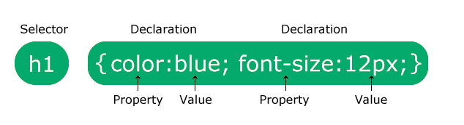

Slide 4
What is a selector?
A CSS selector is the first part of a CSS Rule.
It is a pattern of elements and other terms that tell the browser which HTML elements should be selected to have the CSS property values inside the rule applied to them.
The element or elements which are selected by the selector are referred to as the subject of the selector.

Slide 5
Types of CSS selectors
Type selector
Attribute selectors
Id selector
Class selector
Universal selector
Pseudo selector
Combinator selector

Slide 6
Type selector
The CSS type selector matches elements by node name.
In other words, it selects all elements of the given type within a document.
h1 {
color: red;
}

Slide 7
Attribute selector
The CSS attribute selector matches elements based on the element having a given attribute.
a[href="https://example.org"]
{
color: green;
}

Slide 8
Id selector
The CSS ID selector matches an element based on the value of the element's id attribute.
In order for the element to be selected, its id attribute must match exactly the value given in the selector.
#demo {
color: red;
}

Slide 9
Class selector
The CSS class selector matches elements based on the contents of their class attribute.
.demo {
color: red;
}

Slide 10
Universal selector
The CSS universal selector (*) matches elements of any type.
* {
color: green;
}

Slide 11
Pseudo class selector
User-action pseudo classes
These pseudo-classes only apply when the user interacts with the document in some way.
These act as if a class had been added to the element when the user interacts with it.
:hover — this only applies if the user moves their pointer over an element, typically a link.
h1:hover {
color:red;
}

Slide 12
Combinator selector
They combine other selectors in a way that gives them a useful relationship to each other.
Descendant combinator – This combines two selectors such that elements matched by the second selector are selected if they have an ancestor (parent, parent's parent, parent's parent's parent, etc.) element
<div class="box"><p>Text in .box</p></div>
<p>Text not in .box</p>
.box p {
color: red;
}

Slide 13
References
https://www.w3schools.com/css/css_selectors.asp
https://www.w3schools.com/tags/tag_div.ASP
https://www.w3schools.com/css/css_margin.asp
https://www.w3schools.com/cssref/pr_background-image.php
https://www.w3schools.com/tags/tag_article.asp
https://www.w3schools.com/css/css_inline-block.asp
https://www.w3schools.com/css/css_padding.asp
https://www.w3schools.com/cssref/sel_hover.php
https://www.w3schools.com/cssref/pr_font_font-family.php
https://www.w3schools.com/css/css_border_color.asp
https://www.w3schools.com/cssref/pr_border-width.php
https://www.w3schools.com/css/css_border.asp

Slide 14
Program link
https://onlinegdb.com/8ndIgFvUQ
https://onlinegdb.com/3D9Md-2OL
https://onlinegdb.com/rM-kTikDy

Slide 15
Week 5 assignment
Go to → https://www.freecodecamp.org/learn/2022/responsive-web-design/
Complete steps 26 to 91 of “Learn Basic CSS by building a Cafe Menu”

Slide 16
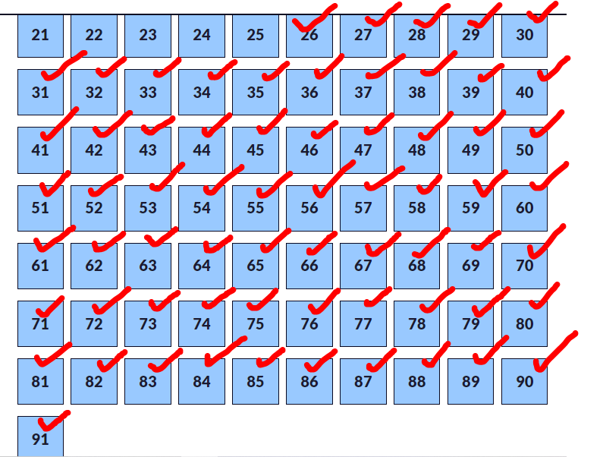
Week 5 assignment

Slide 17
Thank you

